Slide 1

Eventage
Tom Croteau, Rony Alvarez, Andrew Manuele
Wiki: https://github.com/paceuniversity/cs6392016team1/wiki
YouTube: https://www.youtube.com/watch?v=2GL4mZM8e_Q

Slide 2
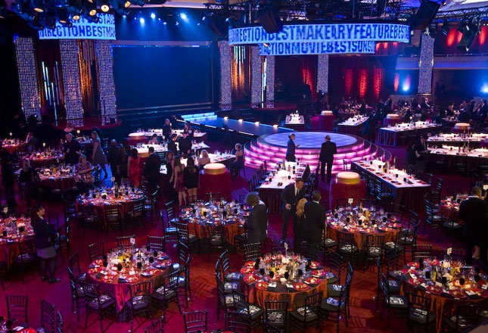
The Problem
Any event these days revolved around social media
You take a picture
Post to Facebook, Twitter, Instagram individually
Time consuming
Takes away from the event

Slide 3
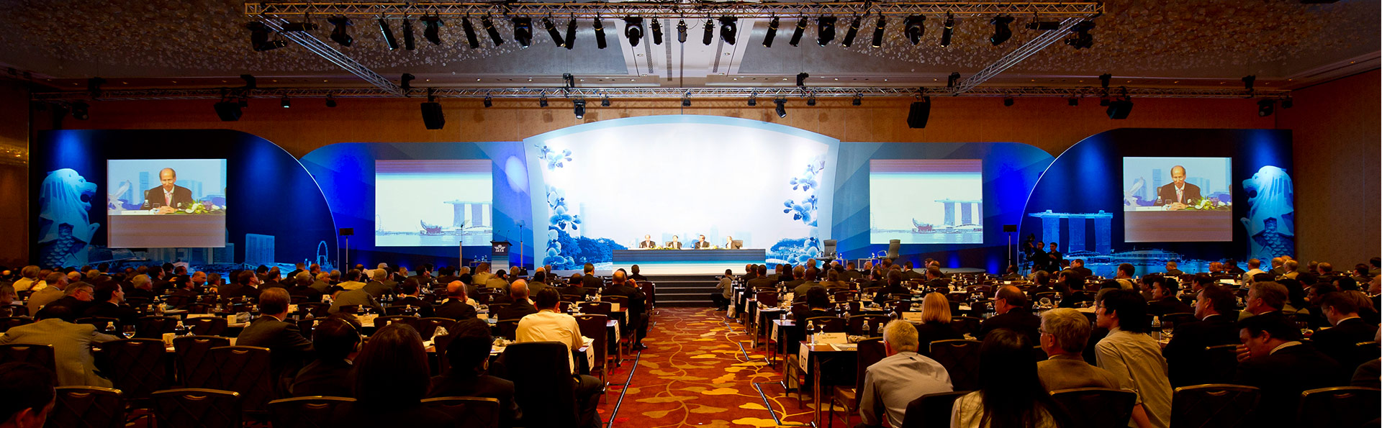
The Solution
John is always on the road
Conventions for work, not for profit events, evening galas
John wants his followers on social media to enjoy every event with him, without missing the events himself
With Eventage he can quickly take photos/videos
They will automatically save and be ready for him to view afterwards
He can even choose to save his texts and phone calls!
“Montage Mode” allows him to customize a mini montage of his event

Slide 4
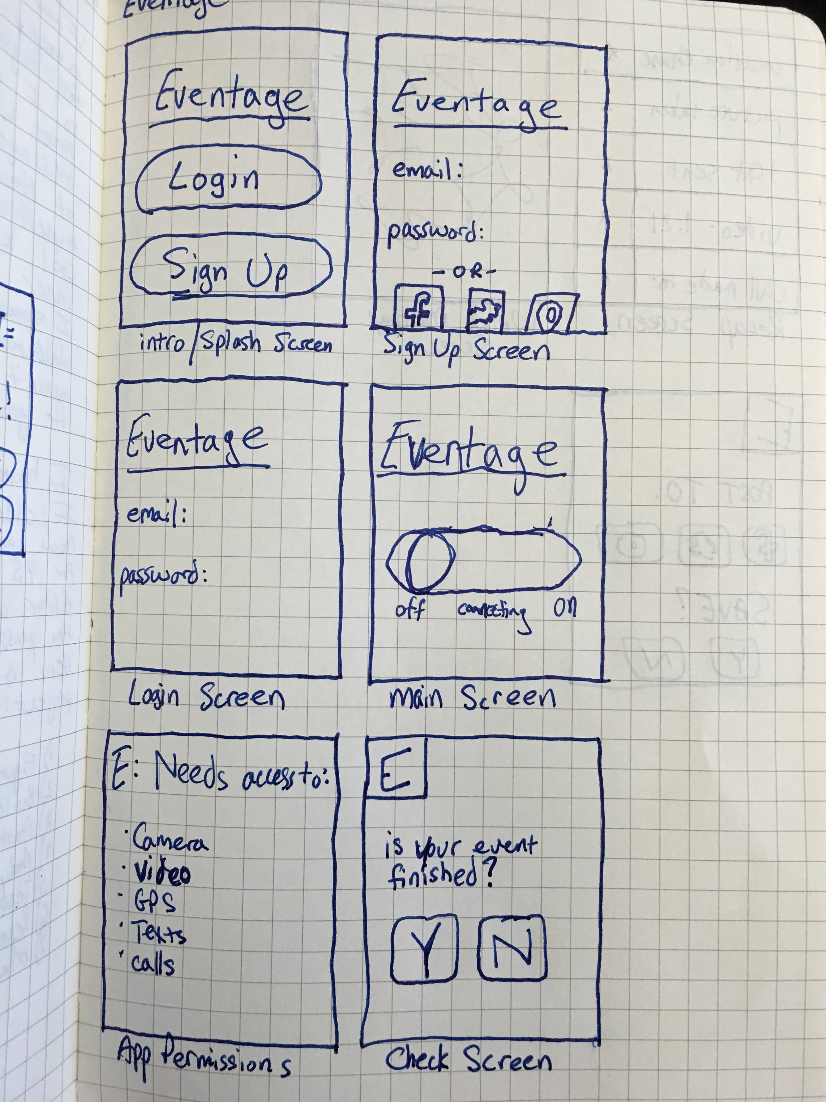
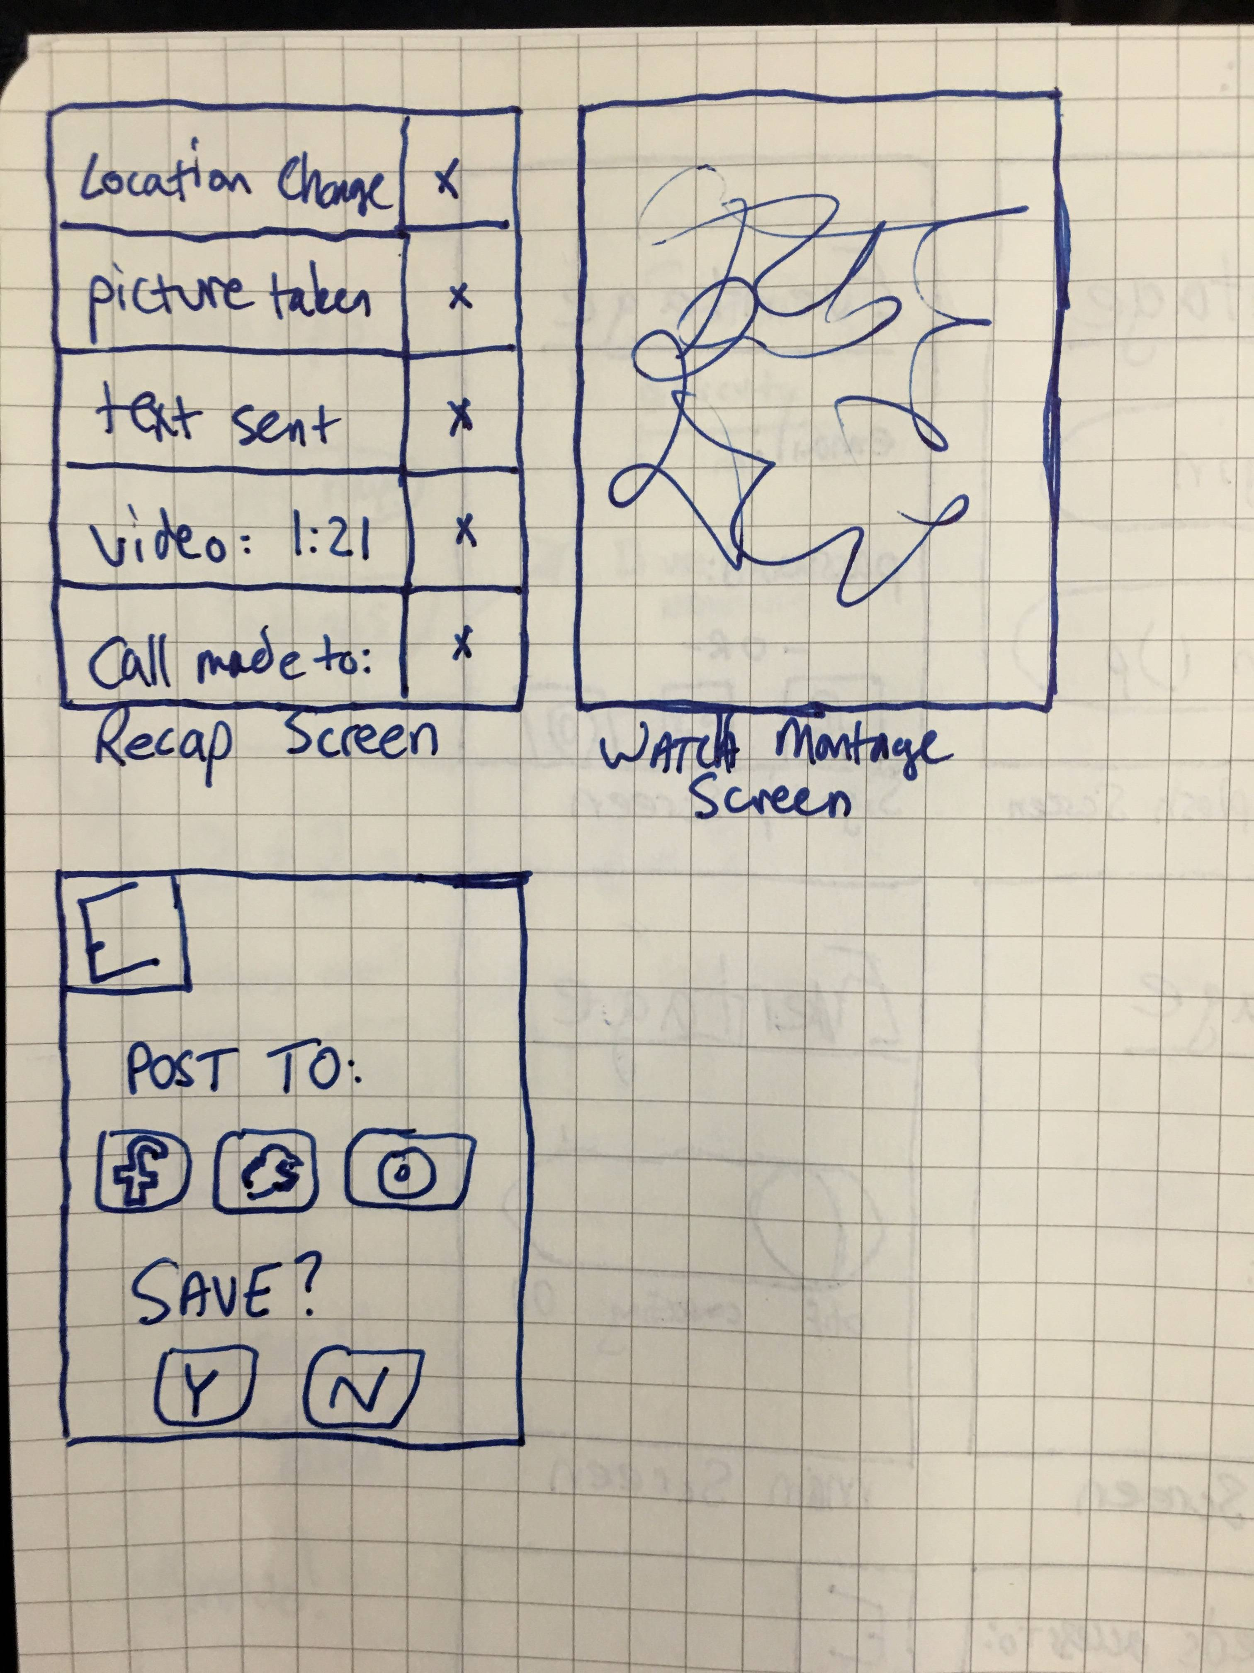
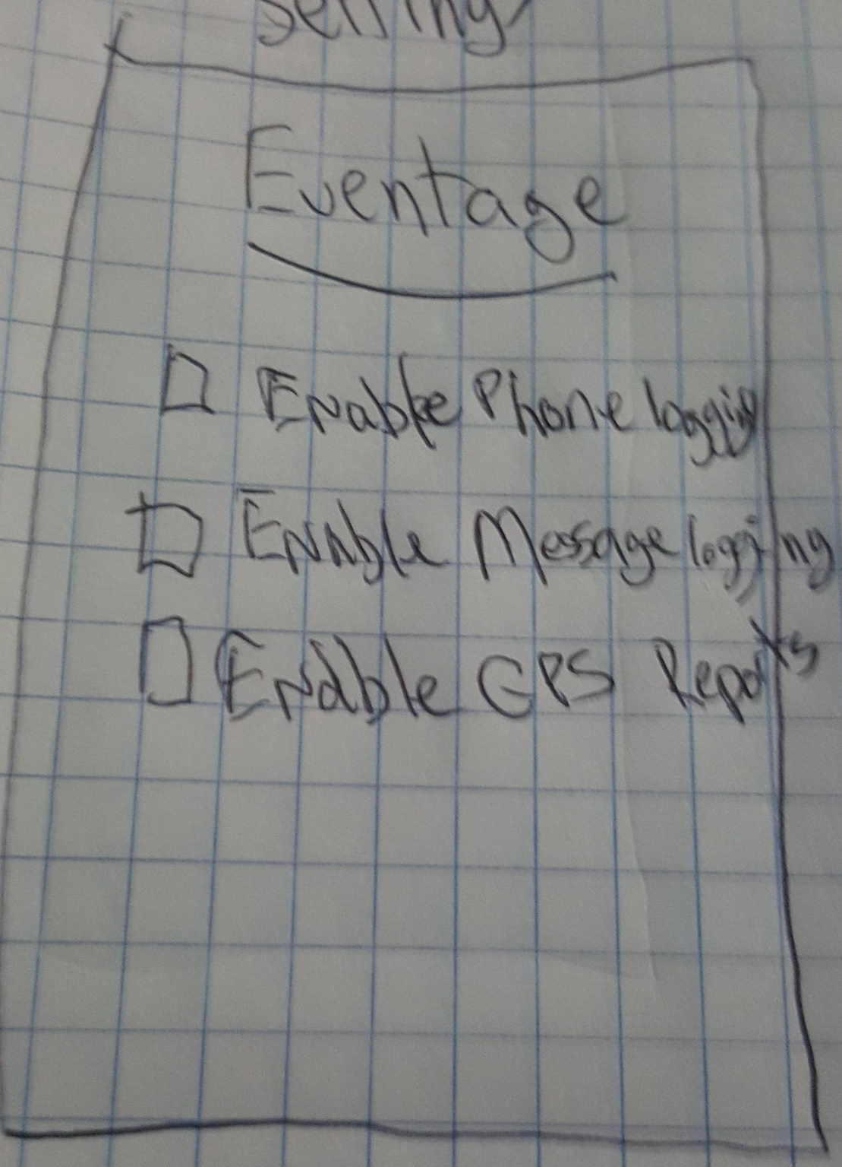
Prototype 1

Slide 5

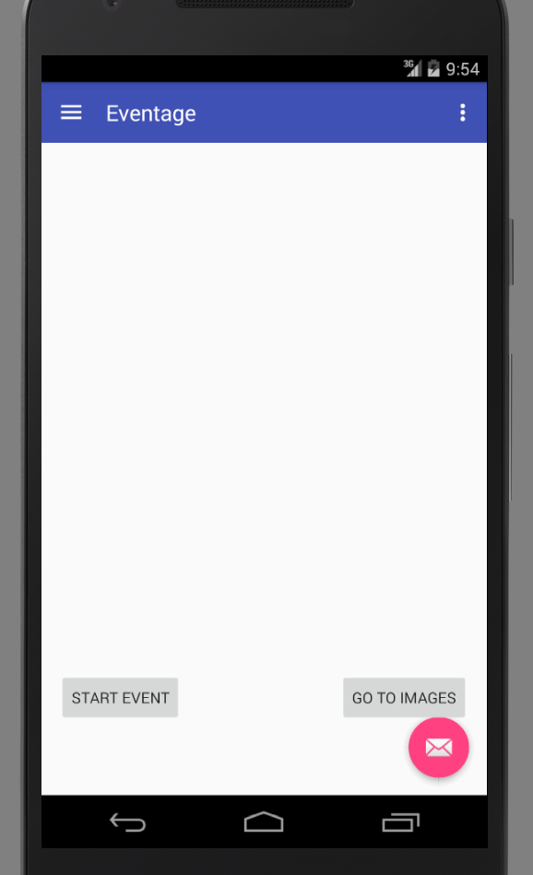
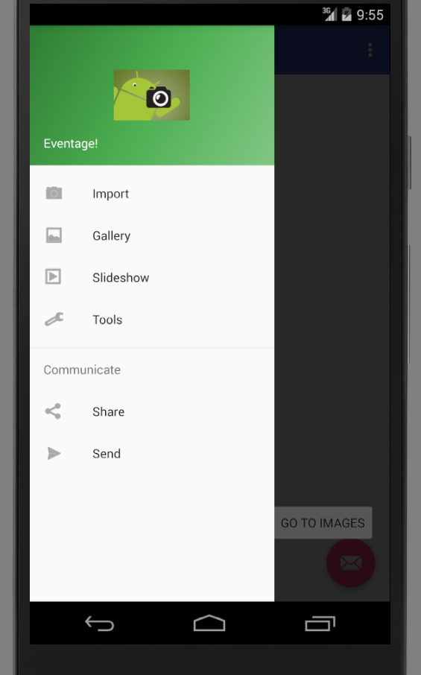
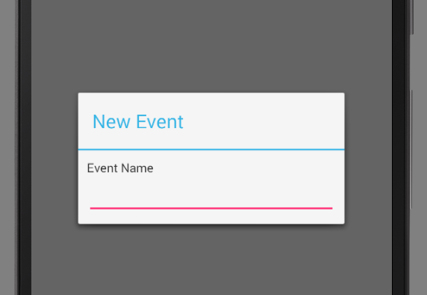
Prototype 2/3

Slide 6
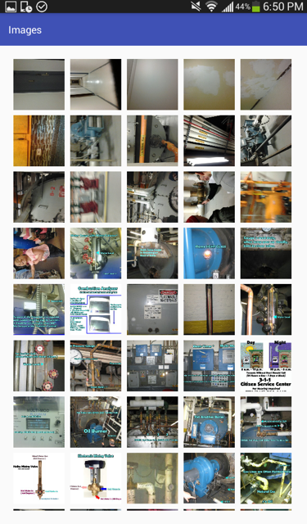
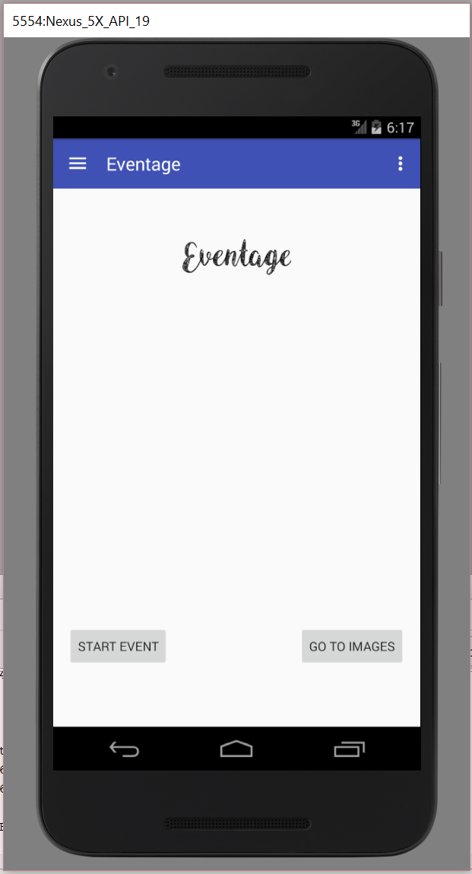
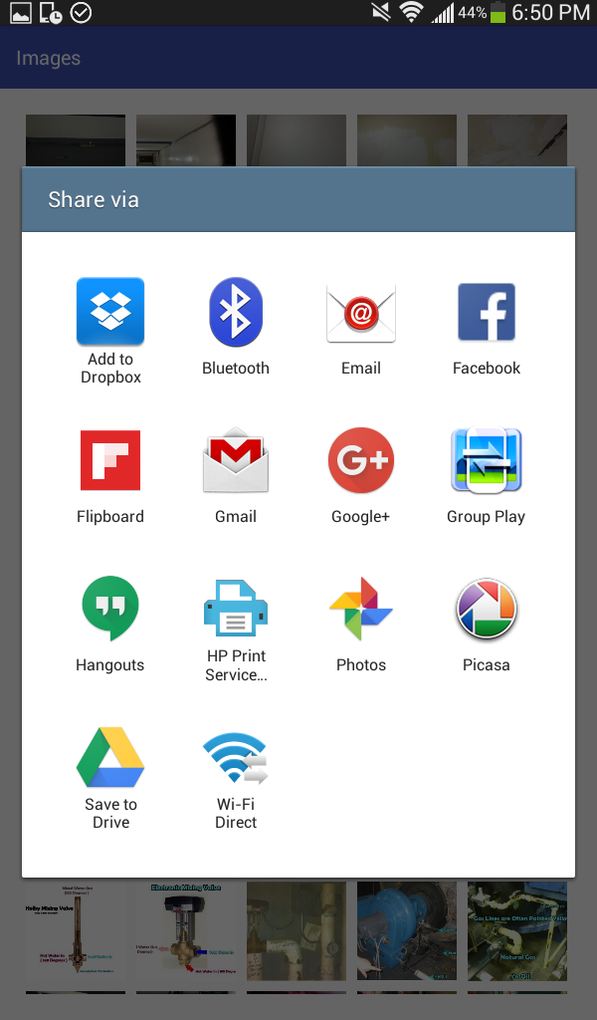
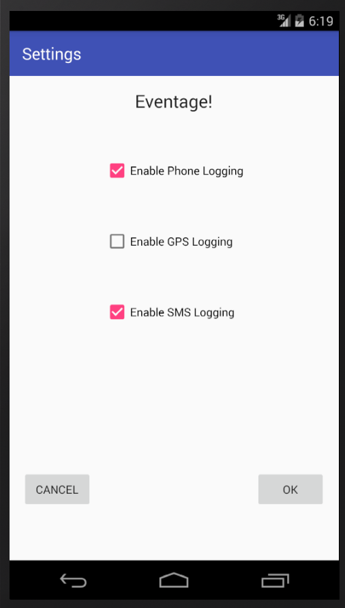
Final Prototype
Notes:
Removed some menu options that weren’t necessary
Settings screen links to a firebase database
Photos able to be seen
Share options shows many different mediaShare

Slide 7
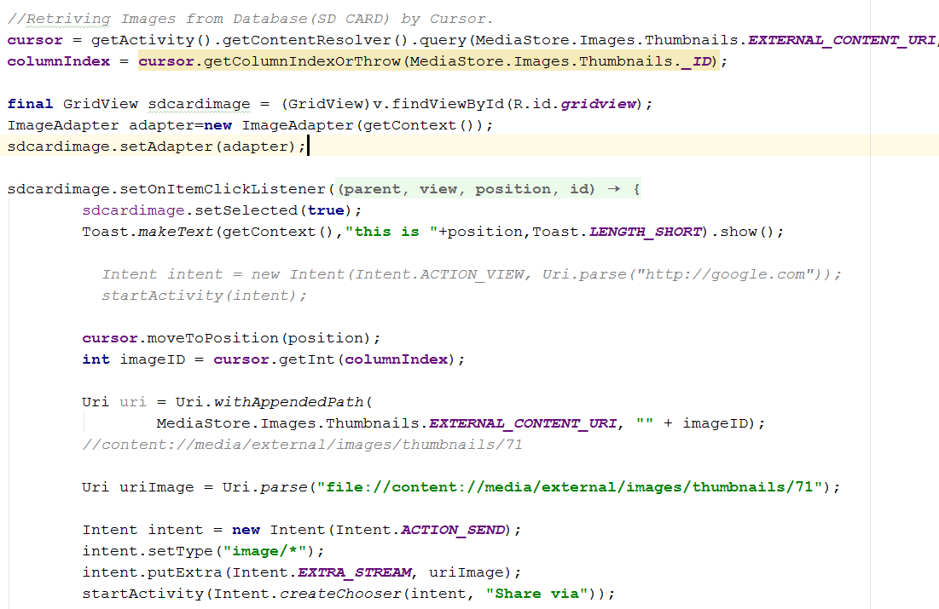
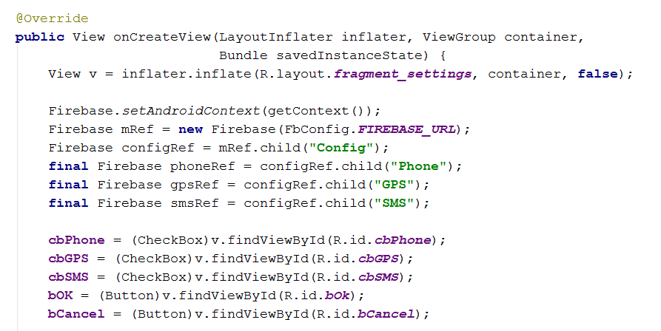
Key Features
Access to phone and gallery through Intents
Save pictures and show them in gallery
MediaStore
Settings to choose if you want texts and phone calls to show up in the montage
Utilizing Firebase to save user preferences when they log in.
Choose Intent added to share videos on Social media

Slide 8
Problems Encountered
Understanding how to get access to gallery for the app
Solution: Needed to use intents and trigger the gallery view through MediaStore
Gather timestamp data so that we could accurately distinguish between a photo from the event
No solution found for this, lastModified() method seems to be closest to complete
Brief issue with overwriting a working version of code in Github with Andrew’s non-working branch
The app we originally designed turned out to be much larger than we were able to handle.
We had to curb our enthusiasm with the full scope of this project
A lot of figuring it out on the fly for most of this project

